Slide 1
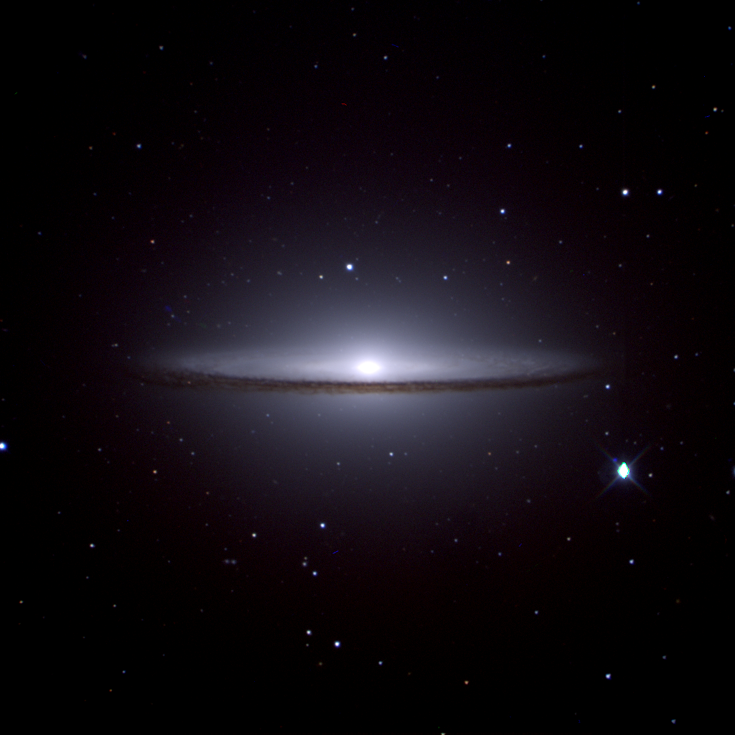
South African Astronomical Observatory
The IO programme
Sprint #25 Review
The IO Team

Slide 2
Vision
Submit observation requests at any time✅
Science on any time scale ✅
Observe from Sutherland, Cape Town or anywhere ✅
Observe manually, queue or service ✅
Respond to alerts, computer generated requests ✅
Automate from science idea –> data acquisition -> publication⏳
Enhance our national and international partnerships ✅
Coordinated science across telescopes in the era of multi-messenger astronomy ✅
Advance SAAO into the 4IR ⏳

Slide 3
Summary
Document Configuration Management
Google NotebookLM for User interface to doc
IO docs
Topswiki
Analysing Observing Logs for Mookodi
Analysis of ATLAS all-sky DAY images for scheduling flats with Mookodi
Analysis of ATLAS All-Sky Night Images for Determining Cloud Coverage
Automation of 74inch + SHOCNWONDER via the OCS
SAAO data archive
Telemetry Project
Alerts Project
New partnership with Hartree Institute UK

Slide 4
Document Configuration Management
IO docs, Topswiki, googledocs ….

Slide 5
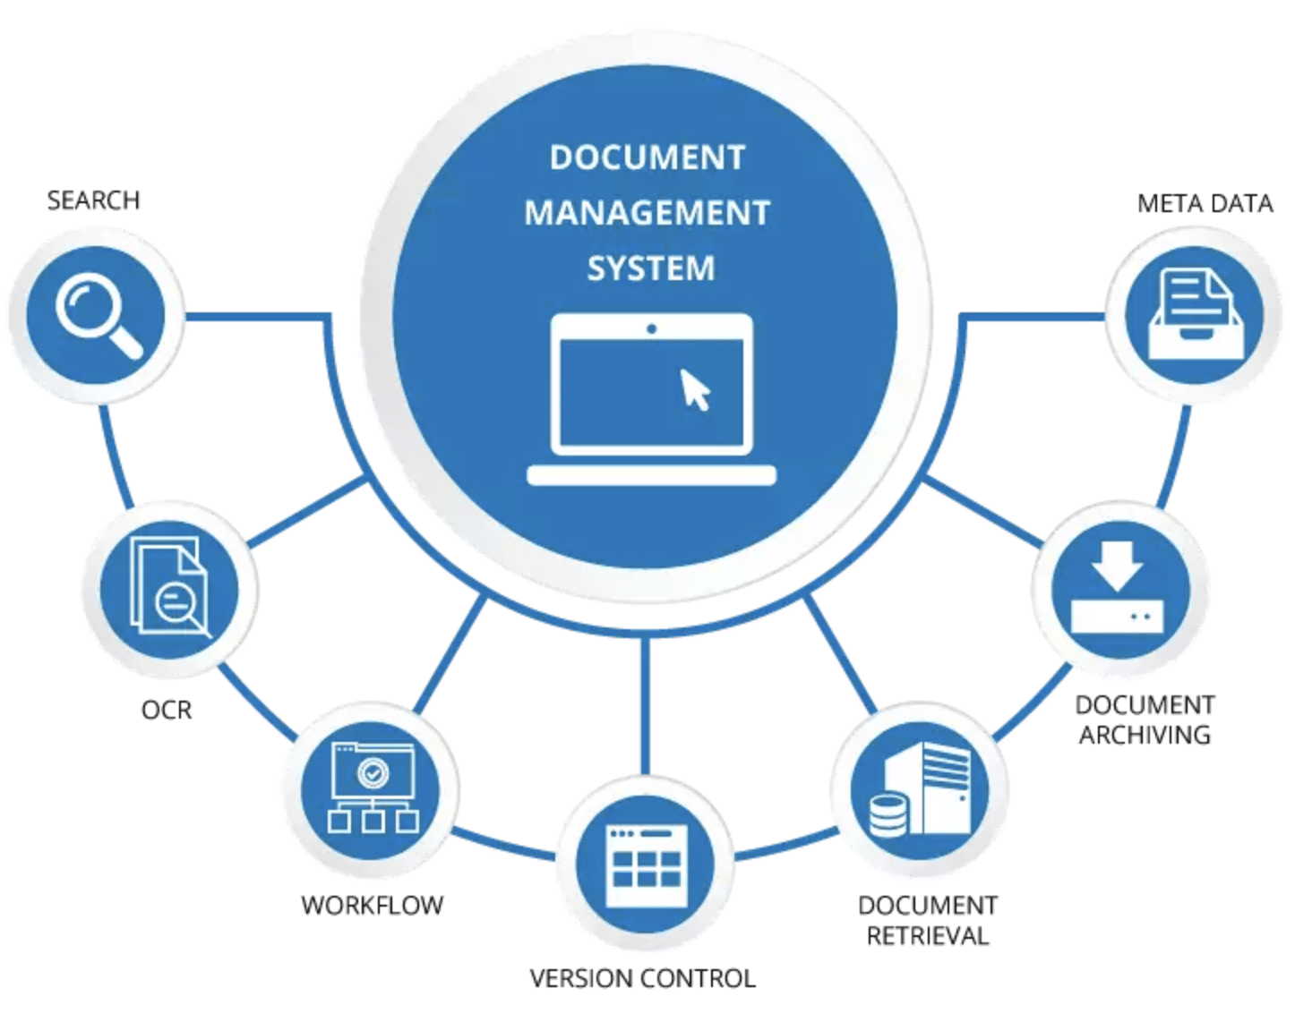

Slide 6
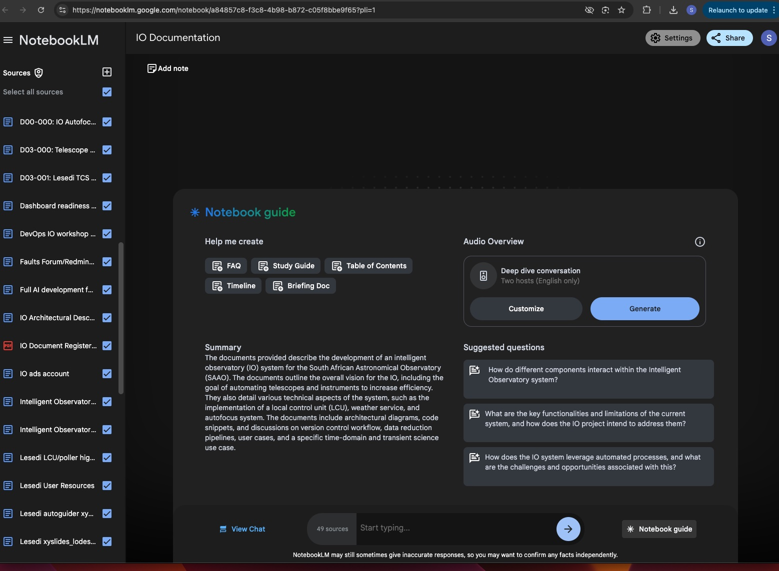

Slide 7
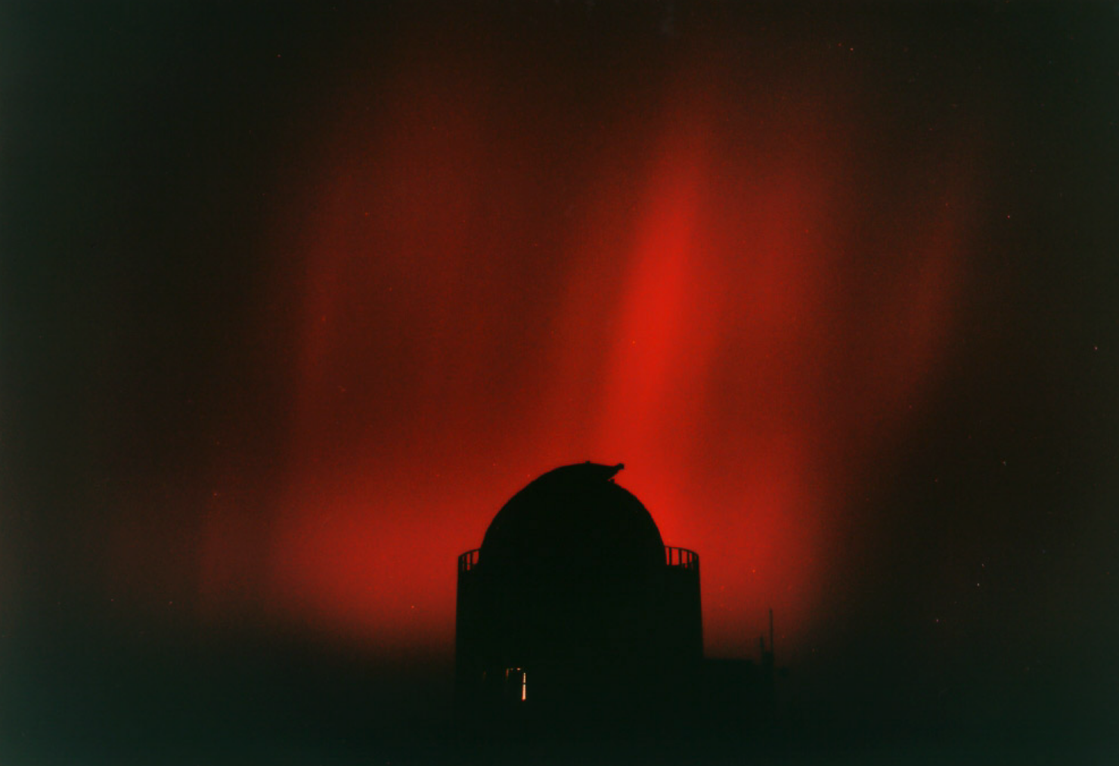
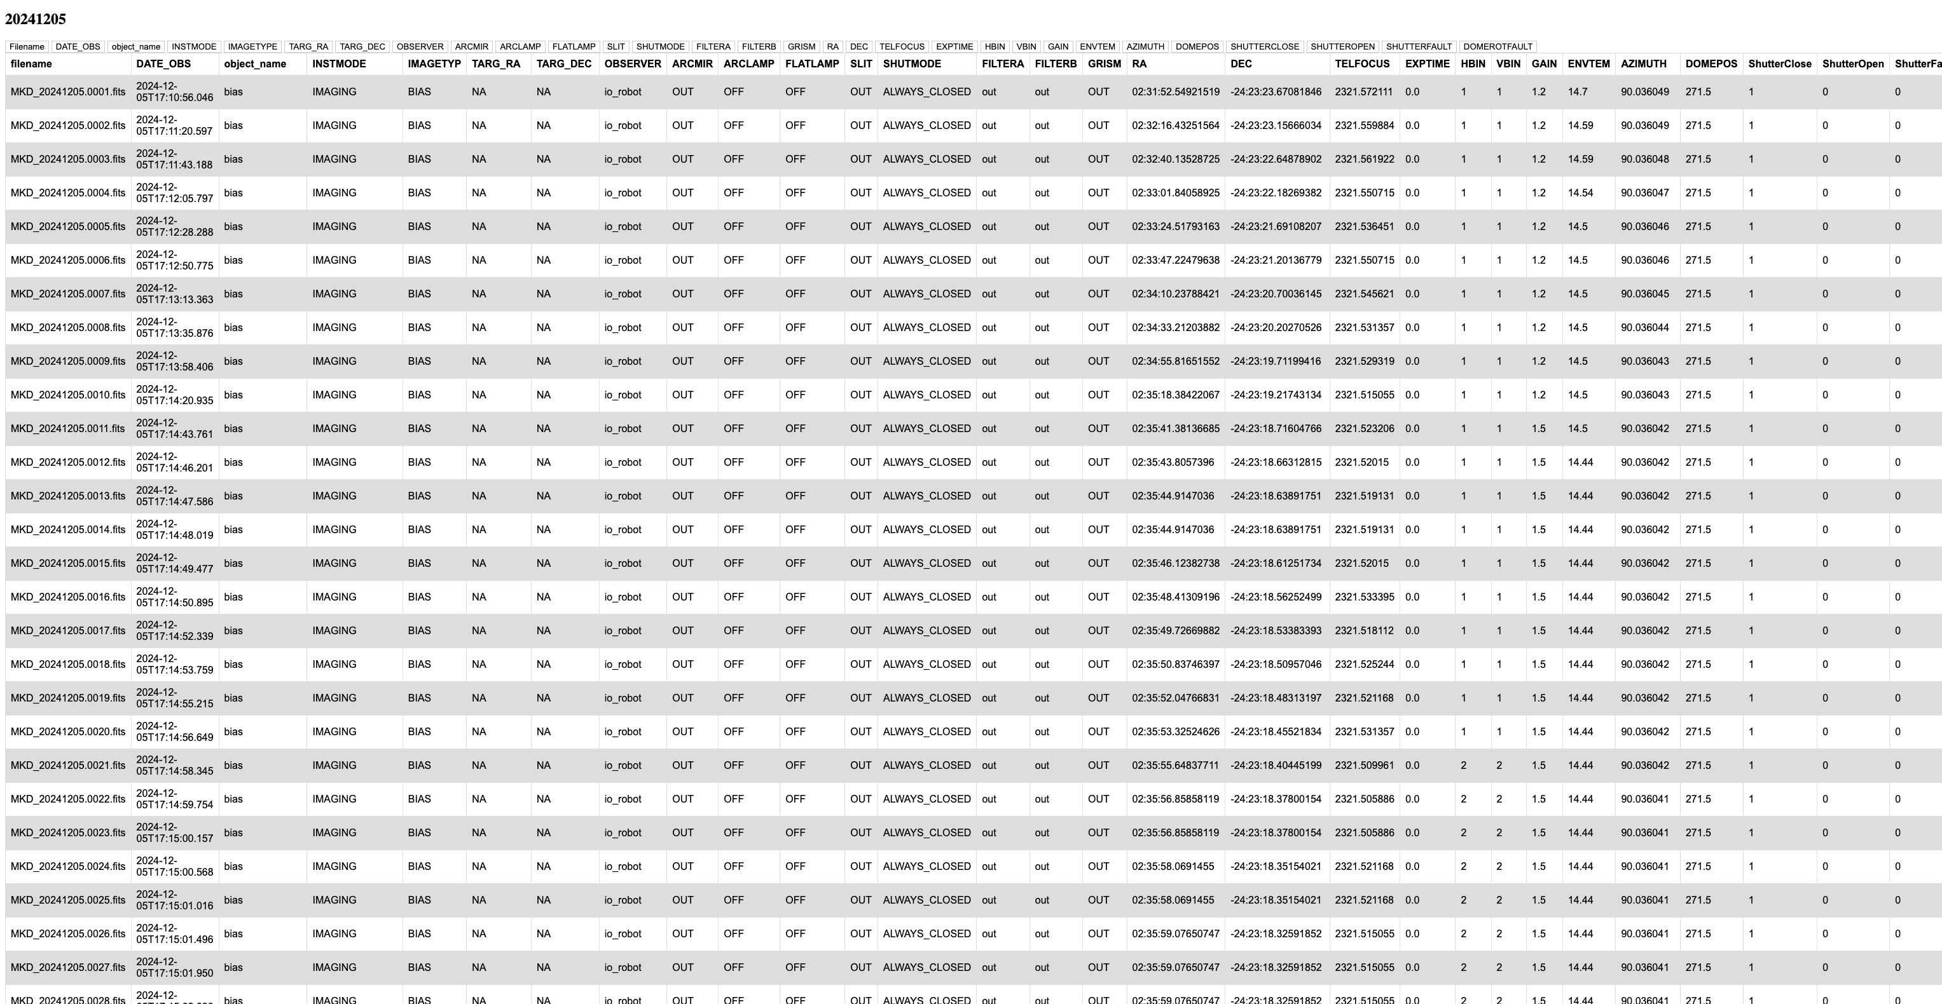
Analysing Observing Logs for Mookodi/Lesedi

Slide 8
Analysing Observing Logs for Mookodi/Lesedi

Slide 9
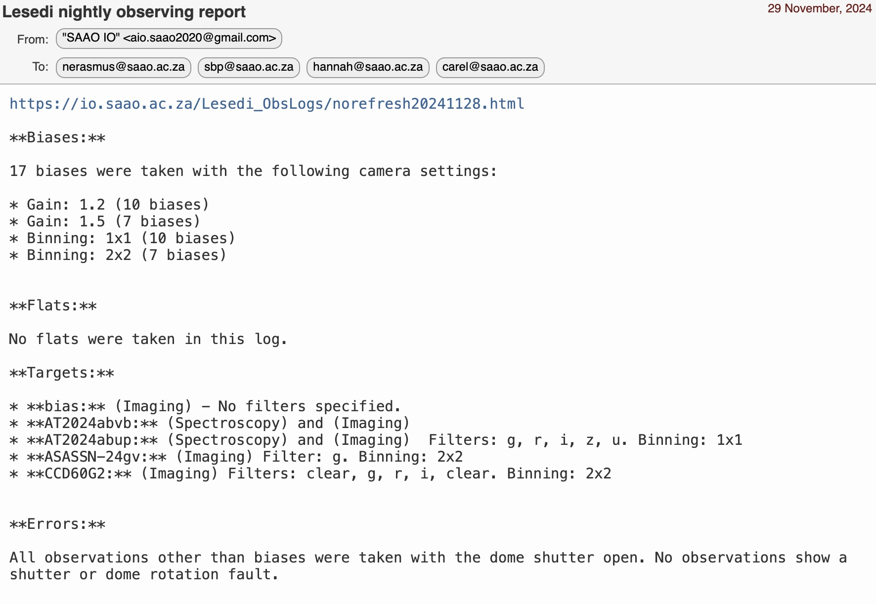
Analysing Observing Logs for Mookodi/Lesedi

Slide 10
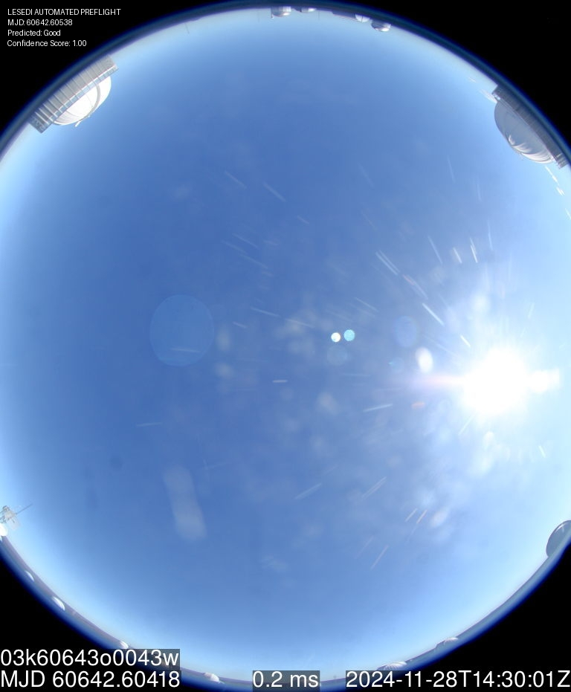
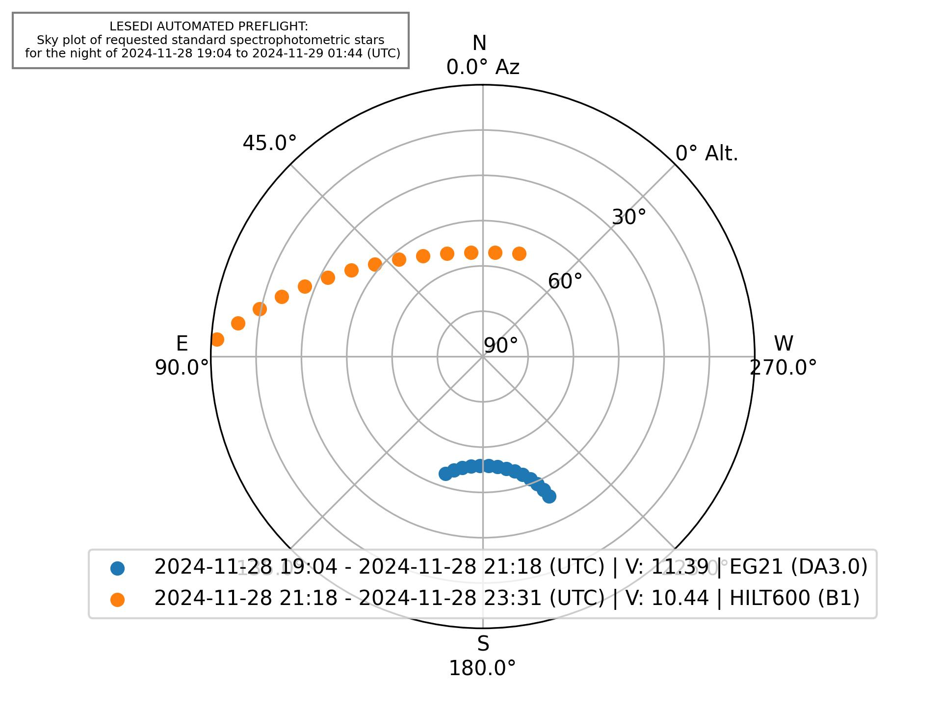
Lesedi Pre-Flight

Slide 11
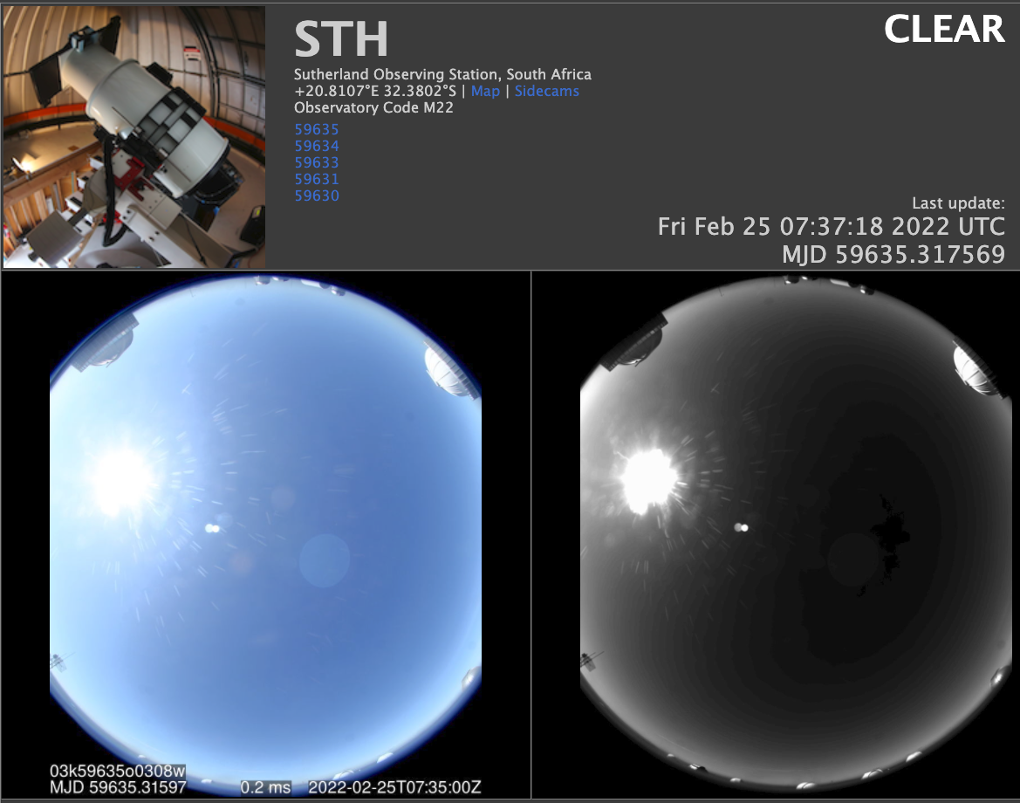
Analysis of ATLAS all-sky DAY images
for scheduling flats with Mookodi

Slide 12
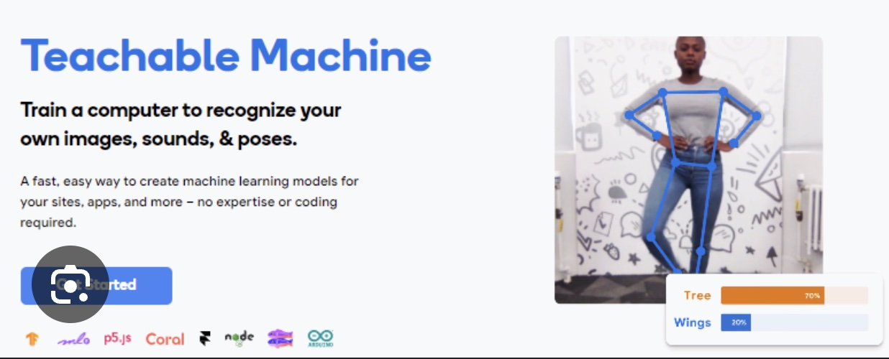
Analysis of ATLAS all-sky DAY images
for scheduling flats with Mookodi
The model is trained on data collected over several months and sorted by cloud cover percentages (GOOD: 0-20%, MARGINAL: 20-40%, BAD: 40-100%).
The model was trained via Google’s Teachable Machines, then implemented in Python using Keras (an open-source deep learning library written in Python).
Image is also verified using computer vision of timestamps embedded within the image).

Slide 13
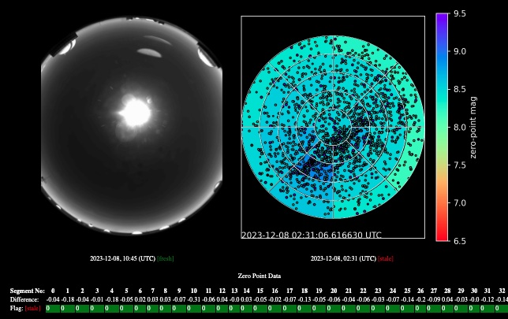
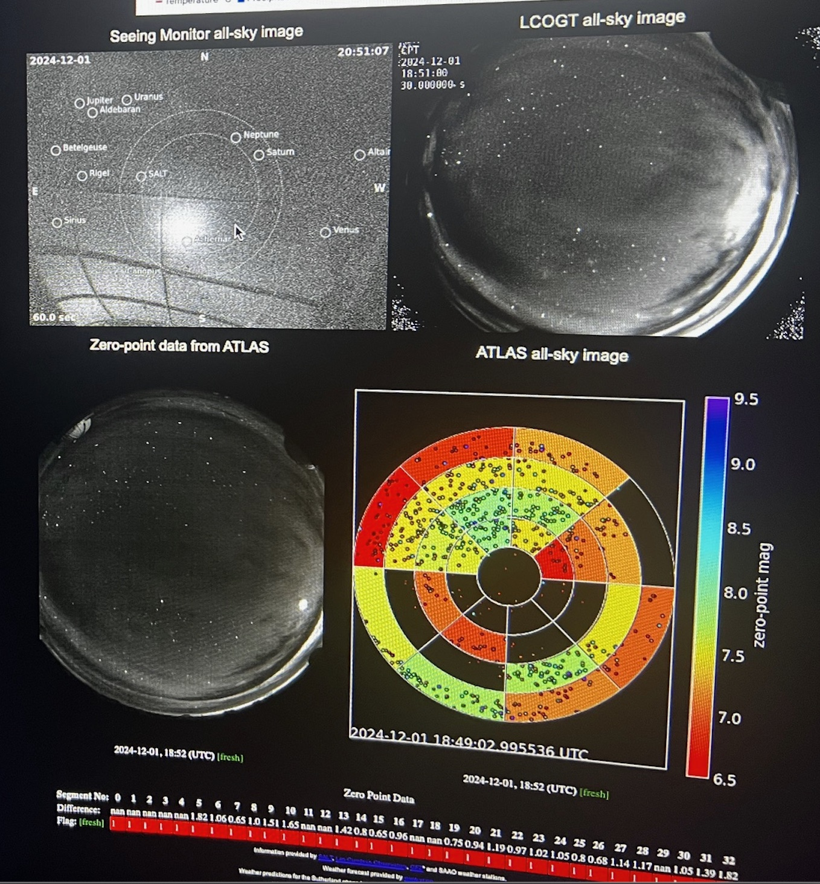
Analysis of ATLAS all-sky NIGHT images
for determining cloud coverage

Slide 14
The Telemetry Project
A unified system to log and analyse telemetry from all instruments and telescopes:
To perform health-checks
Predict necessary maintenance in advance
Produce advanced data products
Requires:
Logging of telemetry
Database design and implementation
AI tools

Slide 15
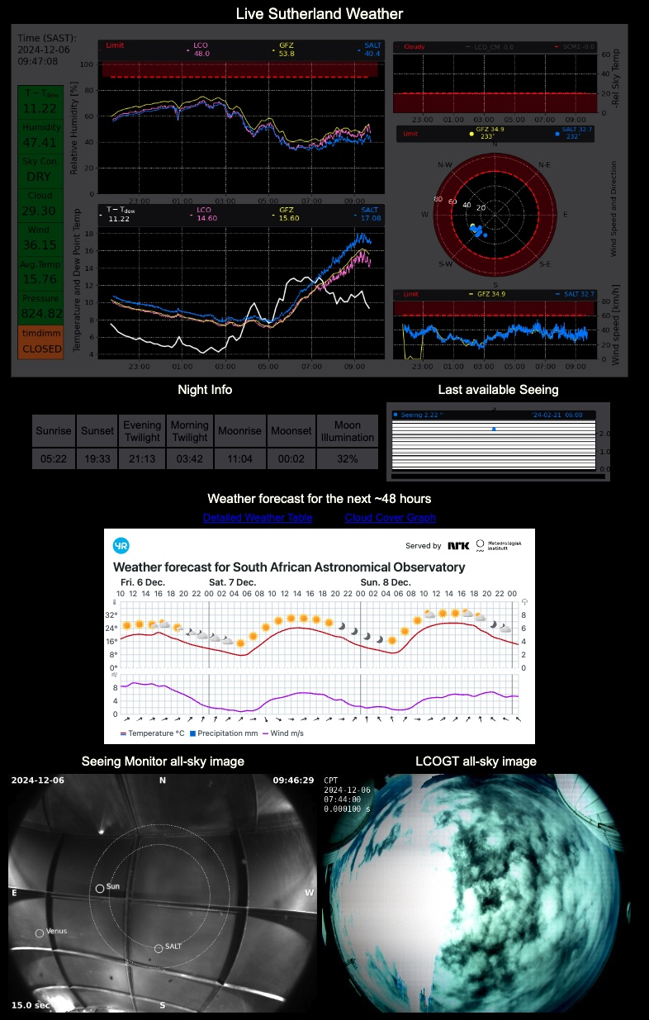
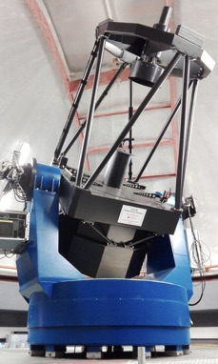
The Alerts Project
A unified system to alert:

Slide 16
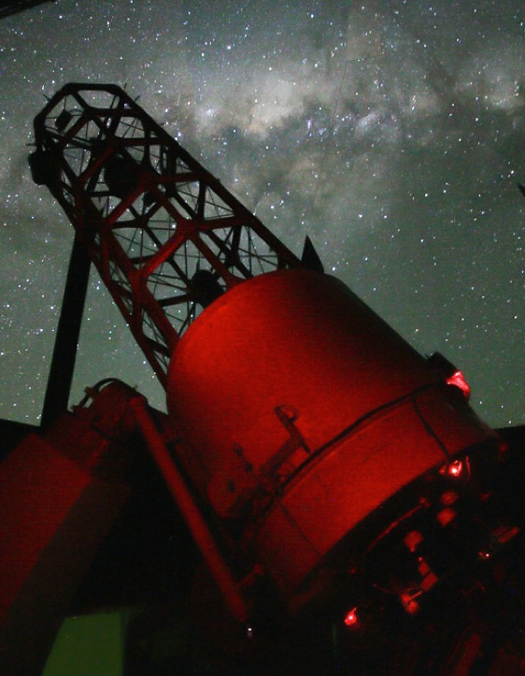
Automation of 74inch+SHOCNWONDER
via the OCS
Testing/fine tuning:
Submit requests via OCS
74inch polls OCS for schedule
74inch executes OCS requests
Point to target RA, Dec
Perform WCS on live image
Fine pointing to magic pixel
Auto focus
Start guiding
Perform observations
Todo:
LCU for weather override etc

Slide 17
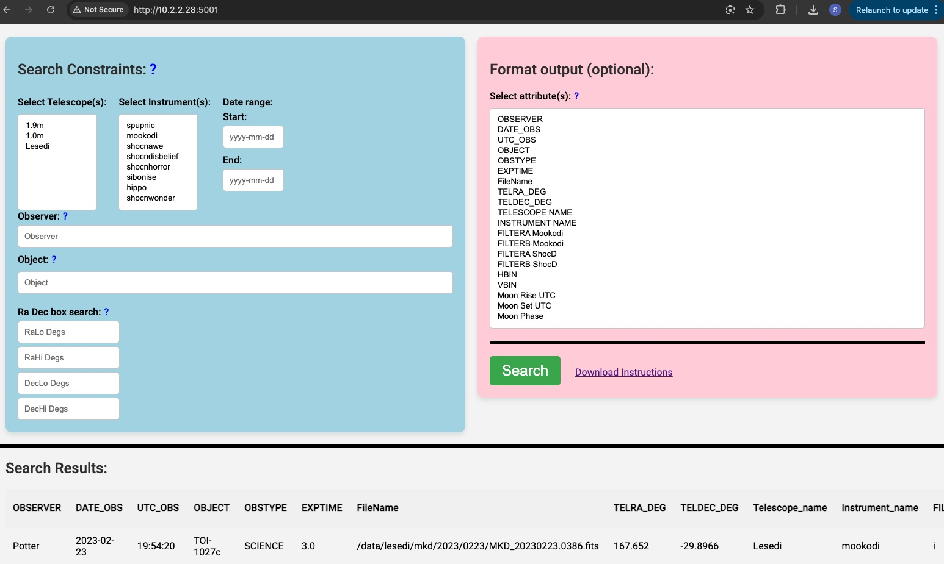
SAAO data archive

Slide 18
New partnership with Hartree Center UK
The Hartree Centre,
Operates under the Science and Technology Facilities Council (STFC), which is part of UK Research and Innovation (UKRI)
established in 2012, is a UK-based research facility specializing in:
high-performance computing (HPC),
data analytics,
and artificial intelligence (AI).
New partnership: NRF – UK Science Technology Research Council

Slide 19
Science
Automation
Telemetry
AI

Slide 20
Summary
Document Configuration Management
Google NotebookLM for User interface to doc
IO docs
Topswiki
Analysing Observing Logs for Mookodi
Analysis of ATLAS all-sky DAY images for scheduling flats with Mookodi
Analysis of ATLAS All-Sky Night Images for Determining Cloud Coverage
Automation of 74inch + SHOCNWONDER via the OCS
SAAO data archive
Telemetry Project
Alerts Project
New partnership with Hartree Institute UK

